Slide 1

Bank Customer Churn

Slide 2
Introduction & problem statement
We aim to accomplish the following for this study:
Identify and visualize which factors contribute to customer churn:
Build a prediction model that will perform the following:
Classify if a customer is going to churn or not
Preferably and based on model performance, choose a model that will attach a probability to the churn to make it easier for customer service to target low hanging fruits in their efforts to prevent churn

Slide 3

Data set cleaning & review
The data frame has 1000 rows with 14 attributes. We review this further to identify what attributes will be necessary and what data manipulation needs to be carried out before Exploratory analysis and prediction modelling

Slide 4
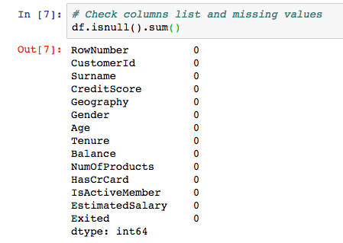
Checking the data for missing values
No missing values!

Slide 5
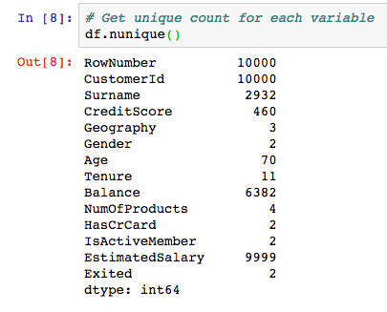
From the below data, we will not require the first 3 attributes as the are specific to a customer. It is borderline with the surname as this would result to profiling so we exclude this as well.

Slide 6
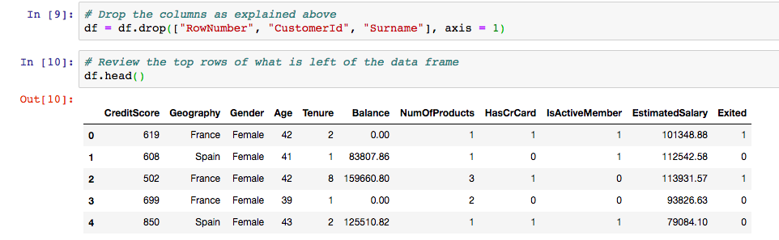
Drop the variables not required
We proceed to model without context even though typically having context and better understanding of the data extraction process would give better insight and possibly lead to better and contextual results of the modelling process

Slide 7
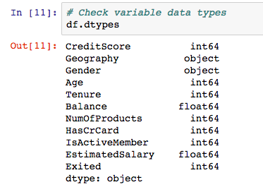
Identifying categorical variables and continuous variables
So we mostly have categorical variables and 5 continuous variables

Slide 8
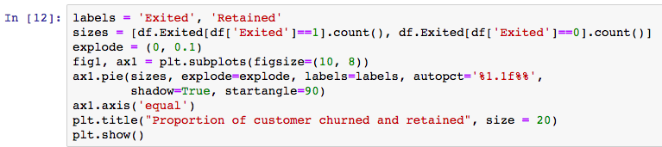
Exploratory Data Analysis
Here our main interest is to get an understanding as to how the given attributes relate to the 'Exit' status.

Slide 9
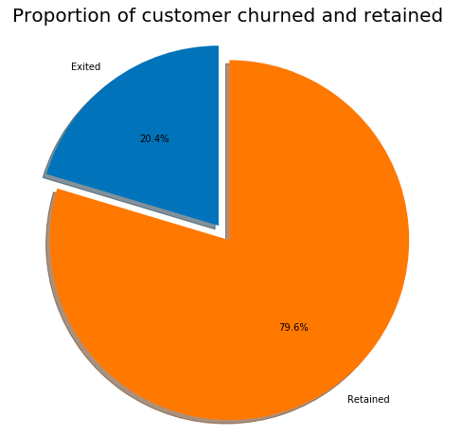
So about 20% of the customers have churned. So the baseline model could be to predict that 20% of the customers will churn. Given 20% is a small number, we need to ensure that the chosen model does predict with great accuracy this 20% as it is of interest to the bank to identify and keep this bunch as opposed to accurately predicting the customers that are retained.

Slide 10
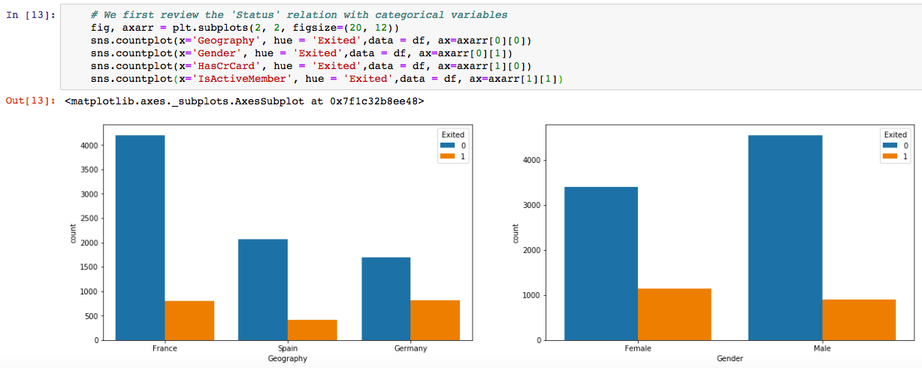
Reviewing the 'Status' relation with categorical variables

Slide 11
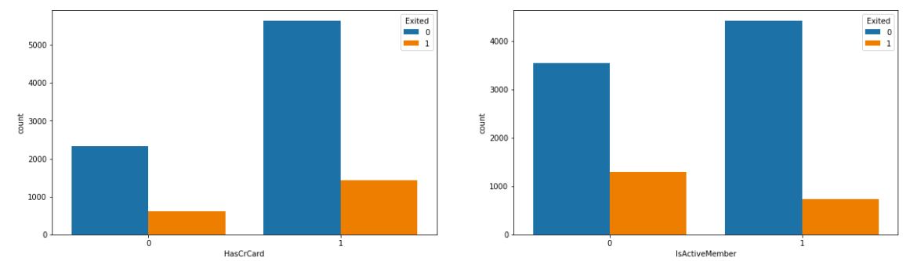
We note the following:
Majority of the data is from persons from France. However, the proportion of churned customers is with inversely related to the population of customers alluding to the bank possibly having a problem (maybe not enough customer service resources allocated) in the areas where it has fewer clients.
The proportion of female customers churning is also greater than that of male customers
Interestingly, majority of the customers that churned are those with credit cards. Given that majority of the customers have credit cards could prove this to be just a coincidence.
Unsurprisingly the inactive members have a greater churn. Worryingly is that the overall proportion of inactive mebers is quite high suggesting that the bank may need a program implemented to turn this group to active customers as this will definately have a positive impact on the customer churn.

Slide 12
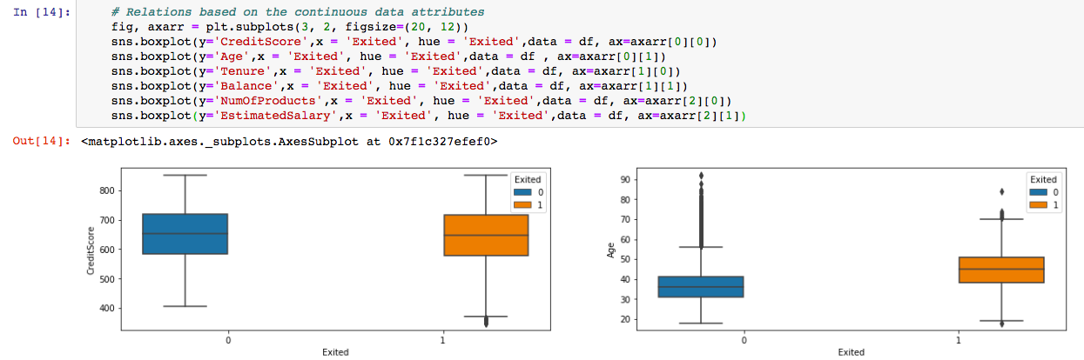
Relations based on the continuous data attributes

Slide 13
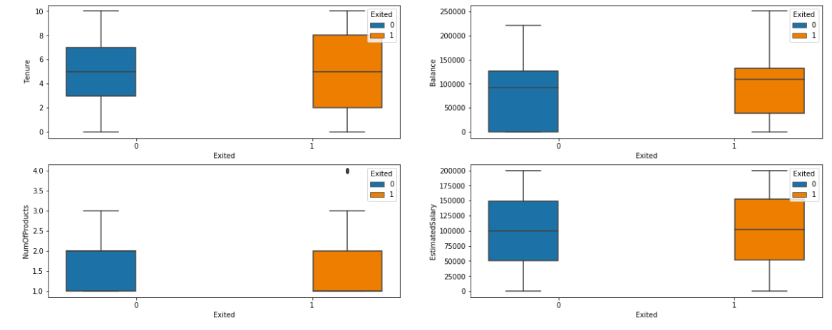
Relations of customers based on the continuous data attributes

Slide 14
We note the following:
There is no significant difference in the credit score distribution between retained and churned customers.
The older customers are churning at more than the younger ones alluding to a difference in service preference in the age categories. The bank may need to review their target market or review the strategy for retention between the different age groups
With regard to the tenure, the clients on either extreme end (spent little time with the bank or a lot of time with the bank) are more likely to churn compared to those that are of average tenure.
Worryingly, the bank is losing customers with significant bank balances which is likely to hit their available capital for lending.
Neither the product nor the salary has a significant effect on the likelihood to churn.

Slide 15
Modelling
Since the output variable is a categorical variable, it is a classification problem. Hence we use the below mentioned models to predict our dependent variable:
Logistic Regression
KNN Classifier

Slide 16
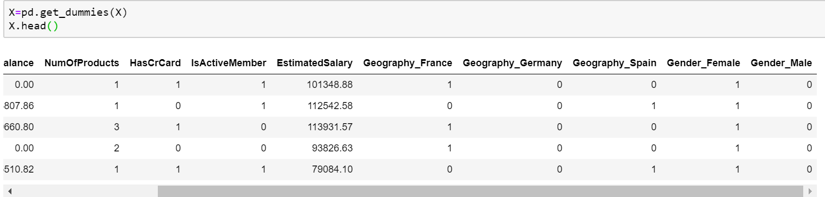
Data Preparation
Using One Hot Encoding for categorical variables

Slide 17
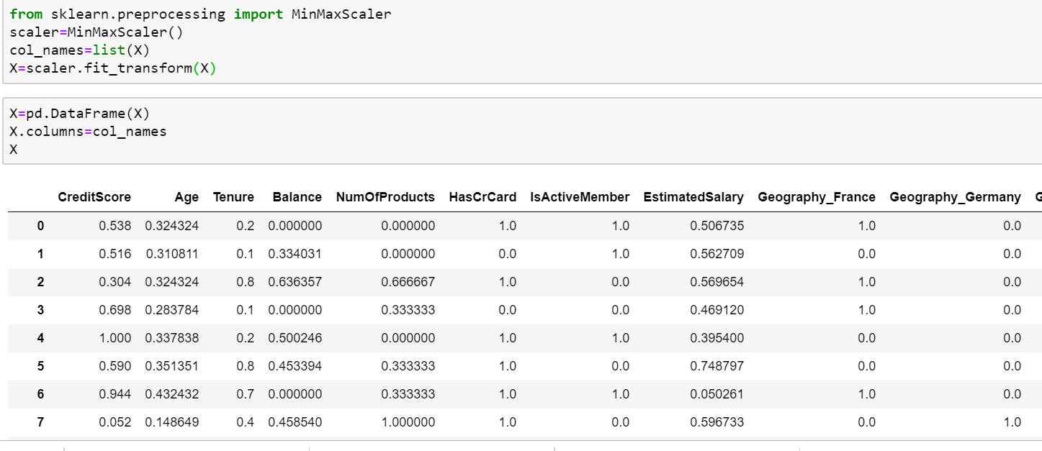
Normalization
Converting all the numerical data into range 0 to 1 using MinMaxScaler function.

